Slide 1

Seeing Ear Bats

Slide 2
Shots Fired Azimuth Detector

Slide 3


Our Team
Aaron Festinger
Mike Bauer

Slide 4
The Challenge of Maintaining Situational Awareness in Combat
Situational awareness is one of the biggest challenges in conducting ground operations. When someone opens fire, it’s often possible to have no awareness of their location, the size of the force, and even their direction of fire and their friendly/enemy status. To quickly spread awareness of an attacking enemy unit, infantrymen are trained to immediately announce the “3Ds,” or the distance, direction, and description of the enemy. This can be effective, but it can also easily fail if the soldier is unable to glean all the information accurately and pass it on.

Slide 5
Acoustic AI for Situational Awareness
Identify Sources of Incoming Fire for Ground Troops
Provide Advanced Warning and Confirmation for Visual Inference
Automate Infantry Call for Fire Procedures

Slide 6
Source Code
https://github.com/OctoConsulting/AudioHack2021

Slide 7
Architecture Diagram
Unity generates 3d spatialized sound of a gun shot
Generated sound is recorded in the engine and written to a new file
New sound file is processed by the model
Direction and distance of that shot is output for further use.

Slide 8
Tools & Technologies Used
Unity
Tensorflow

Slide 9
Generating Synthetic Data
We were able to use the Unity game engine to recreate a 3d environment that simulates a spatialized sound emitter ( gun ).
We can alter the position of this gun’s heading and its distance from our scene “microphone”.
By writing a scripted automation procedure, we randomized those variables and with each shot fired, write out a new 2 channel audio clip based on what was heard from the microphone’s position; annotating the data by including shot azimuth and distance in the file name.
With each test, we were able generate sound data, train the model, and begin inferencing with new clips generated in real-time from our simulator.
Our last pass we generated 2,398 new audio clips in under an hour.

Slide 10
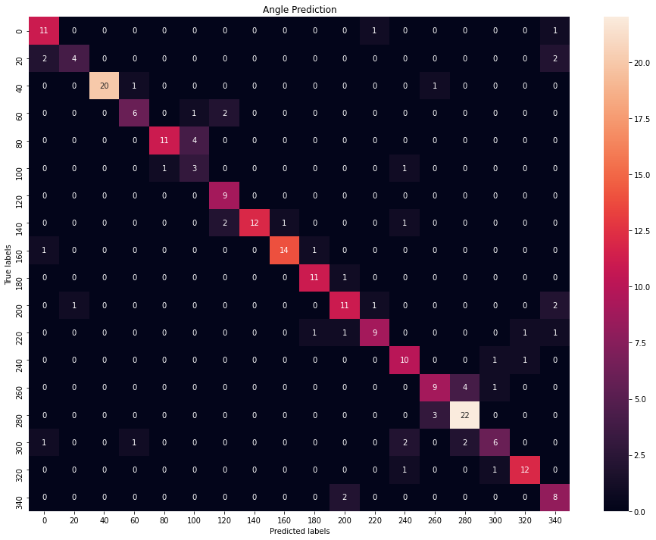
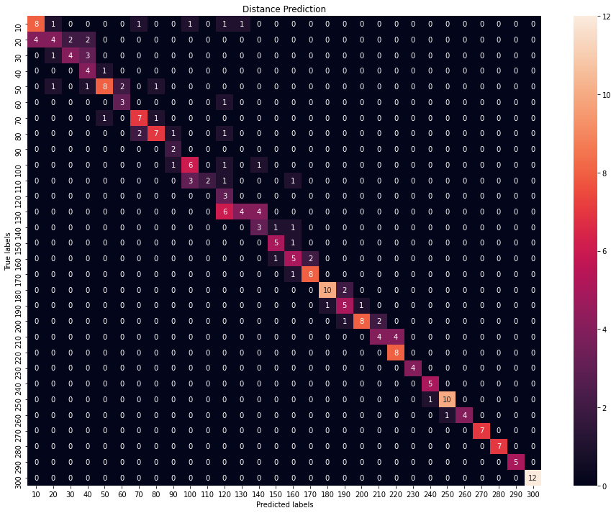
Results
Angles detected to 30 degree precision with 89% accuracy
Range detected to 15 meter precision with 94% accuracy

Slide 11
Future Updates
Bring the model output back into Unity and render the data as a shot line to compare actual and perceived.
Include models of the weapon type and direction of fire

Slide 12
